Slide 1

Version 1.0 Overview
CART
Conservation Assessment & Ranking Tool
August 2019

Slide 2

What is CART?
Conservation
Assessment
Ranking
Tool
Set of Business Practices to streamline Conservation Planning and Program Delivery
Program Neutral integrated Information Technology (IT) Software Application
Any USDA Conservation Program!
Notes:
Priorities in the Farm Bill and Secretary
Streamline programs, increase efficiency and increase customer service – Sonny’s charge ahead of Farm Bill

Slide 3

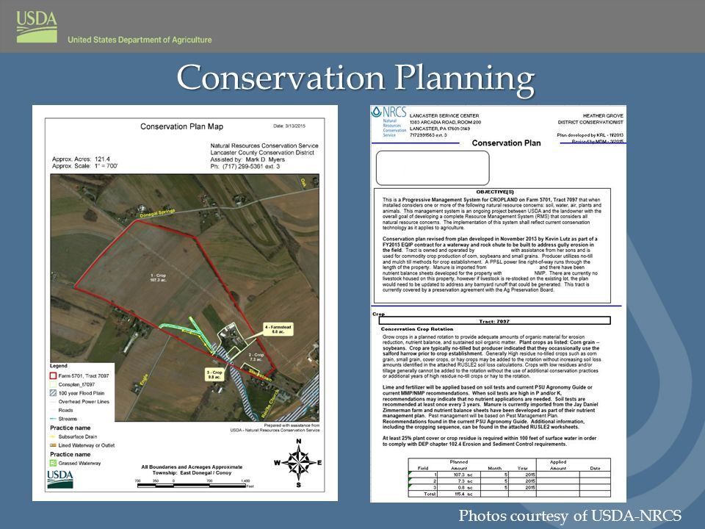
Why CART? (the picture is clear)
Farm Bill =>
Streamline
16-times
NRCS must Streamline
Chief Priorities =>
Implement 2018 Farm Bill
Streamline our process and program delivery
Improve Customer Service
Secretary =>
Streamline Programs
Increase Efficiency
Improve Customer Service
Customers/Partners/Field Offices/NRCS of Future =>
Simplify - Streamline
Notes:
Priorities in the Farm Bill and Secretary
Streamline programs, increase efficiency and increase customer service – Sonny’s charge ahead of Farm Bill

Slide 4
CART structure (complicated version)
Configured Prior to Workflow
Resource Concern, Practices, and Points
Assessment Question Configuration
Geospatial
Questions
Spending Plan and line items
Program Manager Configuration of Ranking Pools
Geospatial
Questions
CPDES
CART
FM
RT
Request For Assistance
Planner Pre-Screens as determined by State
Planner Creates Schedule
Pick PLUs
Planner Creates Assessment
Select RC
Assess Existing Condition including Existing Practices
Select New Practice
Planner Override
Collect Special Concerns Info
Complete Assessment
Client Decision
Planner Ranks Assessment Practices
Identify applicable Ranking Pools
Score Priority Questions
Finalize Score
Estimate Cost by Ranking Pool
Program Manager selects and approves applications
Planner Completes Plan
Digitizes Practices
Contract Wizard
Planner Finalizes
Contract
CA
CPA-52
Client Info and/or Field Visits conducted as appropriate
May Start Application, including eligibility, but must be completed by end of Ranking Process
CART
CPA-52
CD
Protracts
Notes:
Move information at the bottom to the top, need to put in the application process, request for assistance ahead of this workflow – UPDATE NEEDED

Slide 5
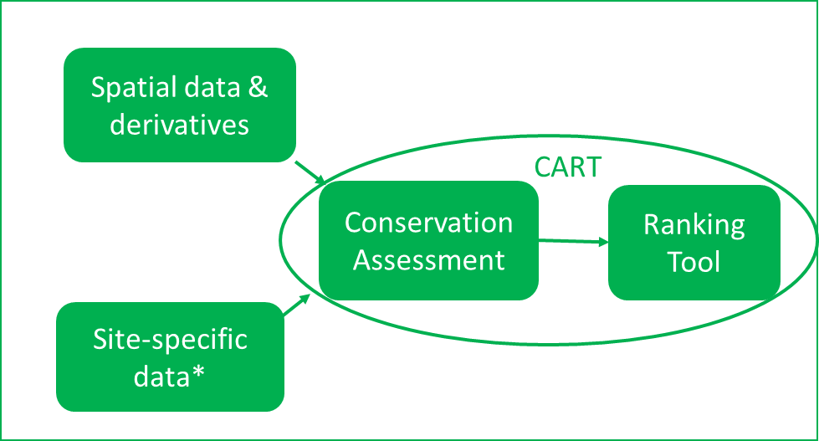
CART structure (simplified version)

Slide 6
Soil Quality Degradation
CART has four resource concerns related to Soil Quality Degradation and each will involve analysis of soil interpretation data from the Soil Data Access Query service. Soil maps and reports for these interpretations are also available from Web Soil Survey. Both applications are connecting to the same soils database.
 | Resource Concern | Soil Interpretation
1 | Subsidence | Agricultural Organic Soil Subsidence
2 | Compaction | Soil Susceptibility to Compaction
3 | Organic Matter Depletion | Organic Matter Depletion
4 | Concentration of Salts and Other Chemicals | Surface Salt Concentration

Slide 7
Soil Data Access Requests by CART
The request for soils data begins once landunits have been selected.
The request is in the form of an SQL query and contains:
Landunit identifier
Bounding coordinates
CART will automatically bundle the request and send it the to Soil Data Access Query Service.
Map layers are processed in the background. and are not displayed.
Park County, Wyoming (245 acres)

Slide 8
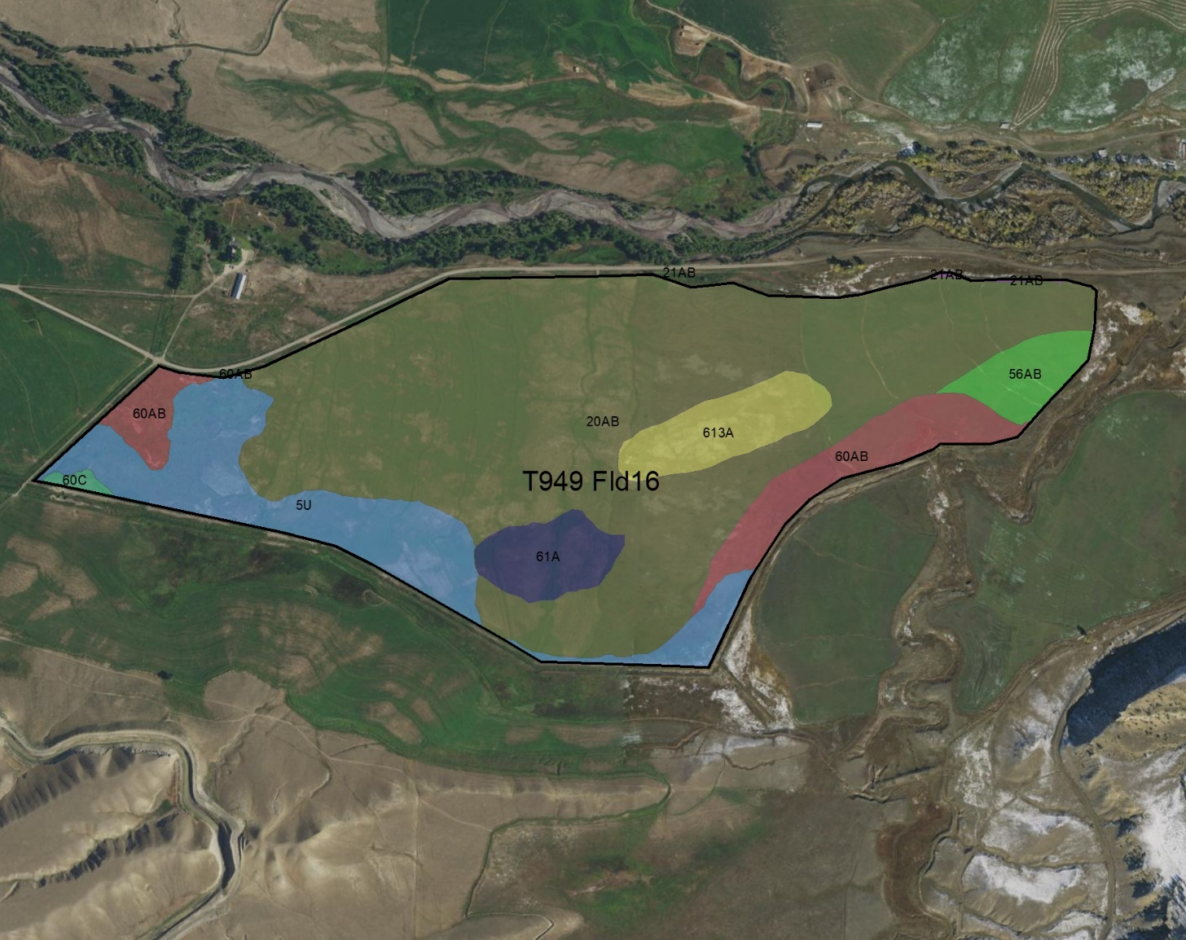
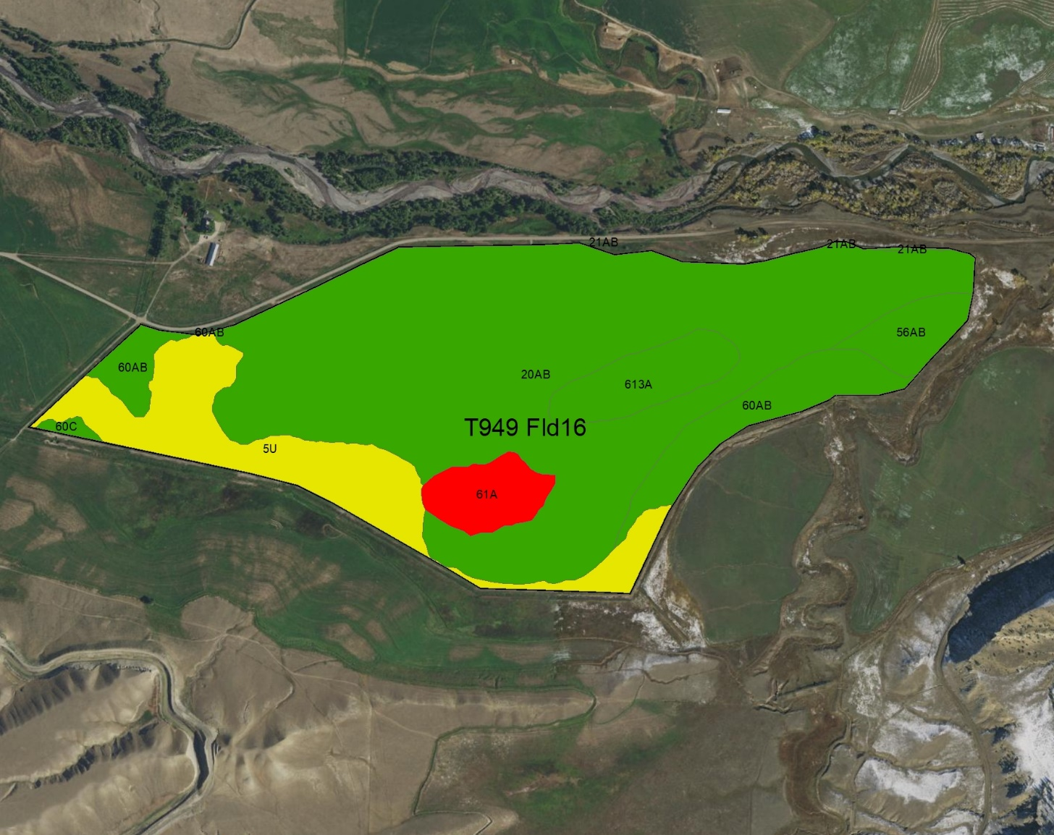
Map data is processed in the background
Basic Soil Map
Risk of Surface Salt Concentration
The map on the left shows 8 different soils within this landunit. The map on the right side illustrates risk of surface salinization. The red polygon indicates an area of high risk for surface salinization, yellow areas have a moderate risk and green areas are low risk.

Slide 9
Service Data
In the example below, the Query service returned statistics for the ‘Risk of Surface Salt Concentration’ within the landunit. The rating data shown in table below is then used to calculate the magnitude of each rating as both a landunit percentage and as landunit acres.
Landunit | Soil Interpretation Name | Soil Interpretation Rating | Rating Number | CART Rating | Rating Percent | Rating Acres | Land Unit Acres | Rolling Percent | Rolling Acres
T949 Fld16 | Surface Salt Concentration | High surface salinization risk or already saline | 1 | Surface Salt Concentration:1 | 3.9 | 9.54 | 244.78 | 3.9 | 9.54
T949 Fld16 | Surface Salt Concentration | Surface salinization risk | 2 | Surface Salt Concentration:2 | 15.2 | 37.20 | 244.78 | 19.1 | 46.74
T949 Fld16 | Surface Salt Concentration | Low surface salinization risk | 3 | Surface Salt Concentration:3 | 80.9 | 198.04 | 244.78 | 100.0 | 244.78
Areas with the highest risk were assigned a rating value of 1. Areas with a lower risk were assigned a higher rating value. These rating values are calculated at the component level. Component acres are estimated using the spatial map unit polygon acres and comppct_r.

Slide 10
Landunit Detailed Ratings
The query calculates the rolling sum values for rating_acres and rating percent for each resource concern and finds the single most limiting rating (per landunit) that comprises at least 10% by area or 10 acres.
Landunit | Soil Interpretation Name | Soil Interpretation Rating | Rating Number | CART Rating | Rating Percent | Rating Acres | Land Unit Acres | Rolling Percent | Rolling Acres
T949 Fld16 | Surface Salt Concentration | High surface salinization risk or already saline | 1 | Surface Salt Concentration:1 | 3.9 | 9.54 | 244.78 | 3.9 | 9.54
T949 Fld16 | Surface Salt Concentration | Surface salinization risk | 2 | Surface Salt Concentration:2 | 15.2 | 37.20 | 244.78 | 19.1 | 46.74
T949 Fld16 | Surface Salt Concentration | Low surface salinization risk | 3 | Surface Salt Concentration:3 | 80.9 | 198.04 | 244.78 | 100.0 | 244.78
In this example for ‘Surface salt concentration’, it is the second row that meets these criteria and will be provided to the CART application as the final landunit rating. It is important to understand that this type of functionality for calculating landunit ratings is not currently available from Web Soil Survey.

Slide 11
Final Landunit Ratings
The final Soil Data Access landunit ratings for each of the resource concerns will be returned to CART for awarding of points. The publication date of the soils data will also be returned to CART as metadata. This will ensure that any of the Soil Quality Degradation ratings can be tied back to a particular version of SSURGO soils data. This is the only information that CART will use in calculating points.
Landunit | Landunit Ratings | Soil Survey Publication Date
T949 Fld16 | Agricultural Organic Soil Subsidence:4 | WY629 2018-09-14 18:51:24
T949 Fld16 | Organic Matter Depletion:2 | WY629 2018-09-14 18:51:24
T949 Fld16 | Soil Susceptibility to Compaction:1 | WY629 2018-09-14 18:51:24
T949 Fld16 | Surface Salt Concentration:2 | WY629 2018-09-14 18:51:24

Slide 12
This domain table contains an ordered list of all possible rating values.
Line | CART Rating | Soil Interpretation Name | Soil Interpretation Rating Class | Rating Number
1 | Surface Salt Concentration:1 | Surface Salt Concentration | High surface salinization risk or already saline | 1
2 | Surface Salt Concentration:2 | Surface Salt Concentration | Surface salinization risk | 2
3 | Surface Salt Concentration:3 | Surface Salt Concentration | Low surface salinization risk | 3
4 | Surface Salt Concentration:4 | Surface Salt Concentration | Not rated | 4
5 | Soil Susceptibility to Compaction:1 | Soil Susceptibility to Compaction | High | 1
6 | Soil Susceptibility to Compaction:2 | Soil Susceptibility to Compaction | Medium | 2
7 | Soil Susceptibility to Compaction:3 | Soil Susceptibility to Compaction | Low | 3
8 | Soil Susceptibility to Compaction:4 | Soil Susceptibility to Compaction | Not rated | 4
9 | Organic Matter Depletion:1 | Organic Matter Depletion | OM depletion high | 1
10 | Organic Matter Depletion:2 | Organic Matter Depletion | OM depletion moderately high | 2
11 | Organic Matter Depletion:3 | Organic Matter Depletion | OM depletion moderate | 3
12 | Organic Matter Depletion:4 | Organic Matter Depletion | OM depletion moderately low | 4
13 | Organic Matter Depletion:5 | Organic Matter Depletion | OM depletion low | 5
14 | Organic Matter Depletion:6 | Organic Matter Depletion | Not rated | 6
15 | Agricultural Organic Soil Subsidence:1 | Agricultural Organic Soil Subsidence | Severe subsidence | 1
16 | Agricultural Organic Soil Subsidence:2 | Agricultural Organic Soil Subsidence | Moderate subsidence | 2
17 | Agricultural Organic Soil Subsidence:3 | Agricultural Organic Soil Subsidence | Low subsidence | 3
18 | Agricultural Organic Soil Subsidence:4 | Agricultural Organic Soil Subsidence | Mineral soil | 4
19 | Agricultural Organic Soil Subsidence:5 | Agricultural Organic Soil Subsidence | Not rated | 5

